Slide 1
CDOT Updates
Conifer Area Council
Town Hall Meeting
February 16, 2022

Slide 2
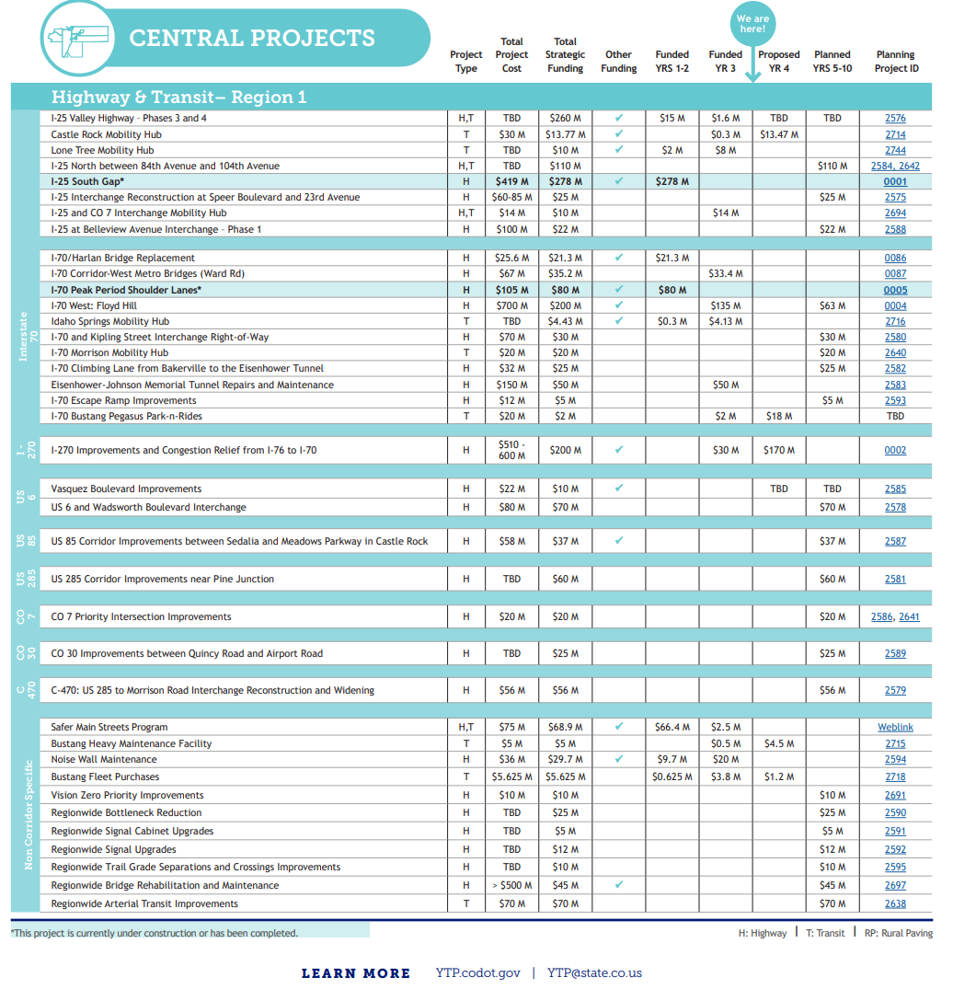
CDOT’s 10-Year Plan
In 2019, CDOT began the process to build a 10-year vision plan for our state’s transportation system, meeting with Coloradans in every county and connecting with residents in their communities. Thousands of comments and ideas became the basis for a prioritized list of transportation projects. The resulting 10-Year Vision document identifies transportation improvements across the state.

Slide 3
CDOT’s 10-Year Plan
US 285 Corridor Improvements near Pine Junction:
The project includes widening US 285 to four lanes and building a depressed median, as well as acceleration and deceleration lanes at interchanges between Richmond Hill and Shaffers Crossing and an interchange at Kings Valley. *
* As recommended in the US 285: Foxton Rd to Bailey Environmental Assessment (EA)

Slide 4
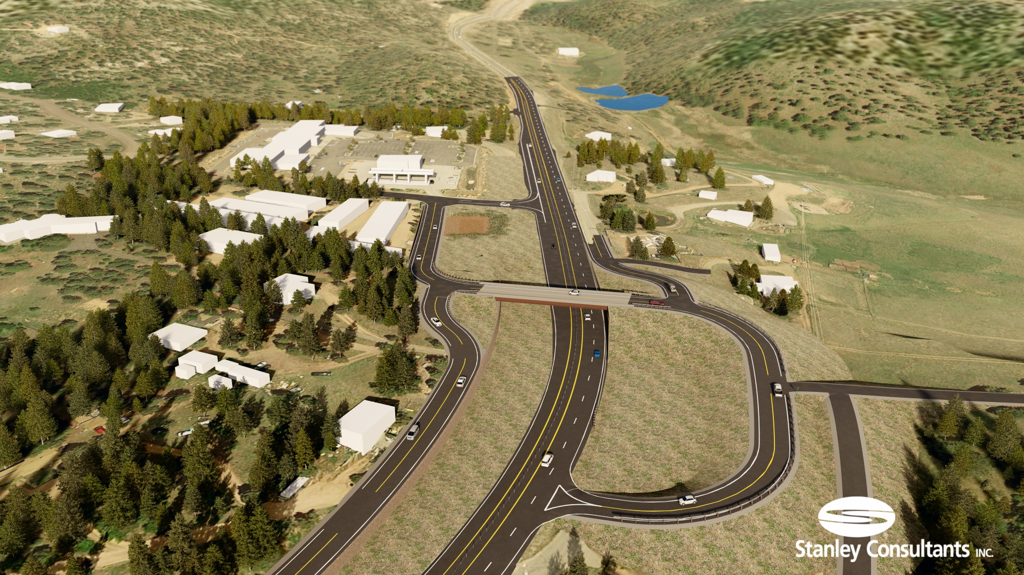
US-285 & Kings Valley Drive
What was the original (2004) Preferred Alternative for the Kings Valley Drive Interchange?
Kings Valley Dr. overpass of US 285,
4-thru lanes and 22-ft grassy median
Cost:
$15M (Bridge Only) Note: depicted here
$30M (Bridge & 4-lanes)

Slide 5
US-285 & Kings Valley Drive
What caused the design to be put on-hold?
During the Federally required Environmental Re-Evaluation, a “new finding” was discovered.
Historic Structure:
Conley Coffee Shop - historic designation after completion of EA
Directly impacted or “used”
Protected by Federal Regulation
23 CFR Part 774 Section 4(f)

Slide 6
US-285 & Kings Valley Drive
What does Federal Regulation - 23 CFR Part 774 Section 4(f) say?
Section 4(f) requirements stipulate that FHWA and other DOT agencies cannot approve the use of land from publicly owned parks, recreational areas, wildlife and waterfowl refuges, or public and private historical sites unless the following conditions apply:
There is no feasible and prudent avoidance alternative to the use of land; and the action includes all possible planning to minimize harm to the property resulting from such use;
OR
The Administration determines that the use of the property will have a de minimis impact.
Section 4(f) applies to any Department of Transportation funded project regardless of the NEPA class of action (environmental clearance type) or the timing of the discovery of the Section 4(f) property.
A Section 4(f) analysis is required for DOT actions undergoing NEPA analysis and documentation if properties protected by Section 4(f) would be “used”…

Slide 7
US-285 & Kings Valley Drive
What was does Section 4(f) require CDOT to do?
Determine if there is a feasible and prudent interchange configuration which avoids the use or taking of a historic or other Section 4(f) property.
Determine if the alternative interchange configuration would have lesser or no Section 4(f) impacts when compared to the original alternative.
Document findings and proceed with the final design of the configuration which was deemed least impactful.
If CDOT was unable to find an avoidance alternative, the Section 4(f) process to acquire a historic property would take approximately 2-3 years. (Pushing the shovel ready status to late 2025/early 2026).

Slide 8
US-285 & Kings Valley Drive
What is considered during a Section 4(f) Evaluation?
Safety
Traffic Operations
Environmental Impacts
ROW Impacts
Maintenance Activities
What is not a consideration of a Section 4(f) Evaluation?
Cost. Cost is analyzed to understand rough order of magnitude, however, based on previous court cases, an increased construction cost has not been deemed a reason to consider it infeasible or imprudent.

Slide 9
US-285 & Kings Valley Drive
How many interchange configurations have been considered/studied by CDOT to date?
In total, sixteen (16) interchange configurations have been studied:
9 configurations evaluated in the 2004 EA
8 were dismissed
1 identified as the Preferred Alternative
7 new configurations evaluated in 2021
6 dismissed
1 identified as the Updated Preferred Alternative

Slide 10
US-285 & Kings Valley Drive
When did CDOT decide on the Updated Preferred Alternative?
CDOT completed the alternatives evaluation and analysis in November 2021 and the report was finalized on December 27, 2021.
CDOT consulted with the Federal Highway Administration (FHWA) on our findings and recommendations and received their concurrence to pursue this alternative on January 19, 2022.
April2004
Nov2017
Mar 2018
Dec
2019
Dec2021
May 2022
Dec 2023
TBD
Interim
Solutions Explored
EA
Design
Begins
Historic
Finding
Discovered
Section
4(f)
Analysis
Complete
Updated Alt.
Design
Begins
Design
Complete
Begin Construction
Environmental Assessment Completed

Slide 11
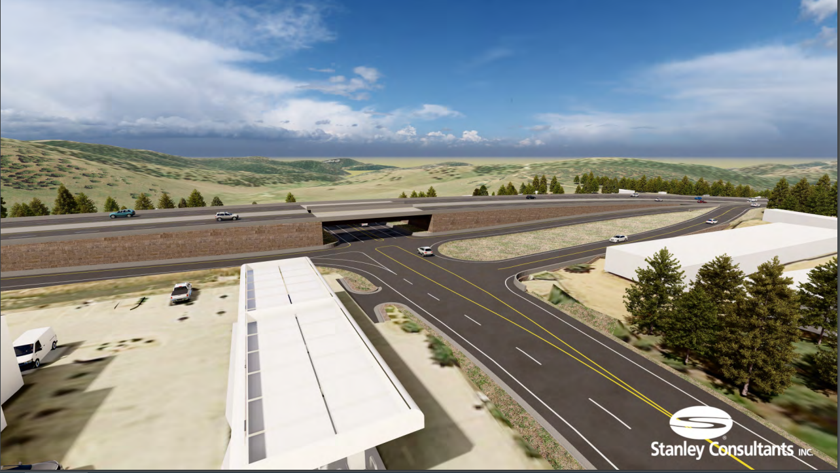
US-285 & Kings Valley Drive
Updated Kings Valley Drive Preferred Alternative:
US-285 Over Kings Valley
Kings Valley Drive remains at-grade (existing elevation)
US-285 is raised to overpass Kings Valley Dr.
Avoids direct impacts to ALL historic structures
Private property ROW impacts are reduced on the south
Same private property ROW impacts north of US-285
←To Denver
To Bailey →

Slide 12
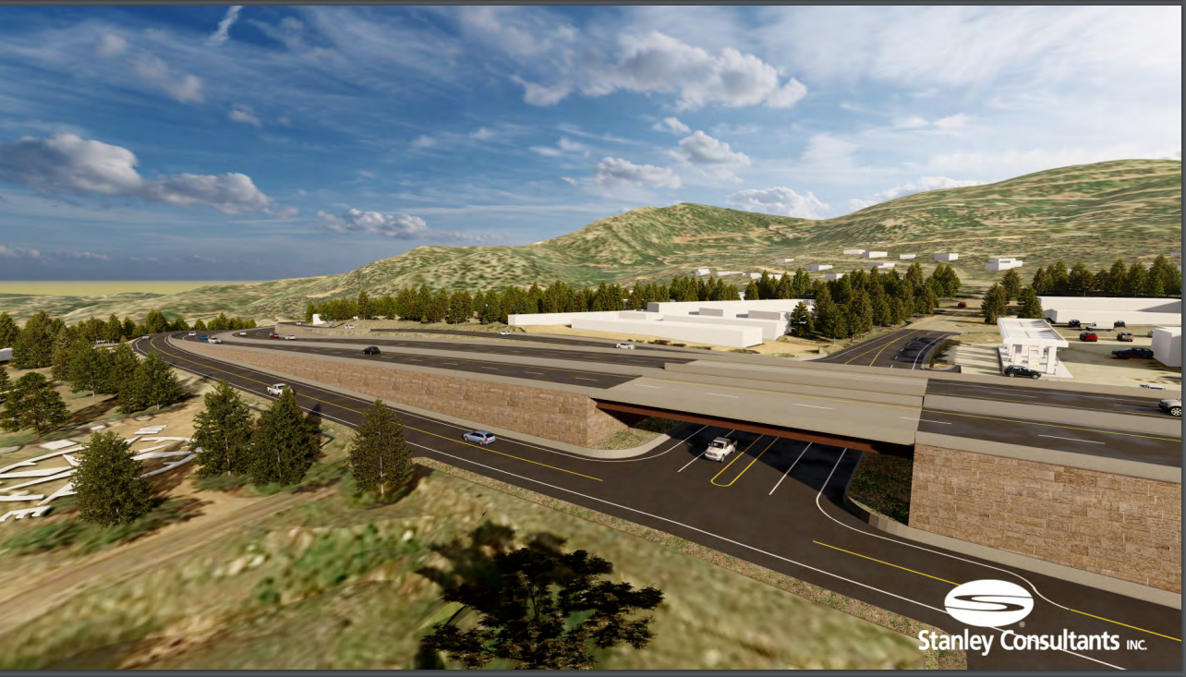
US-285 & Kings Valley Drive
Updated Kings Valley Drive Preferred Alternative
Estimated Cost to Construct: $35-40M, includes 4 lanes on US-285.
← To Bailey
To Denver →

Slide 13
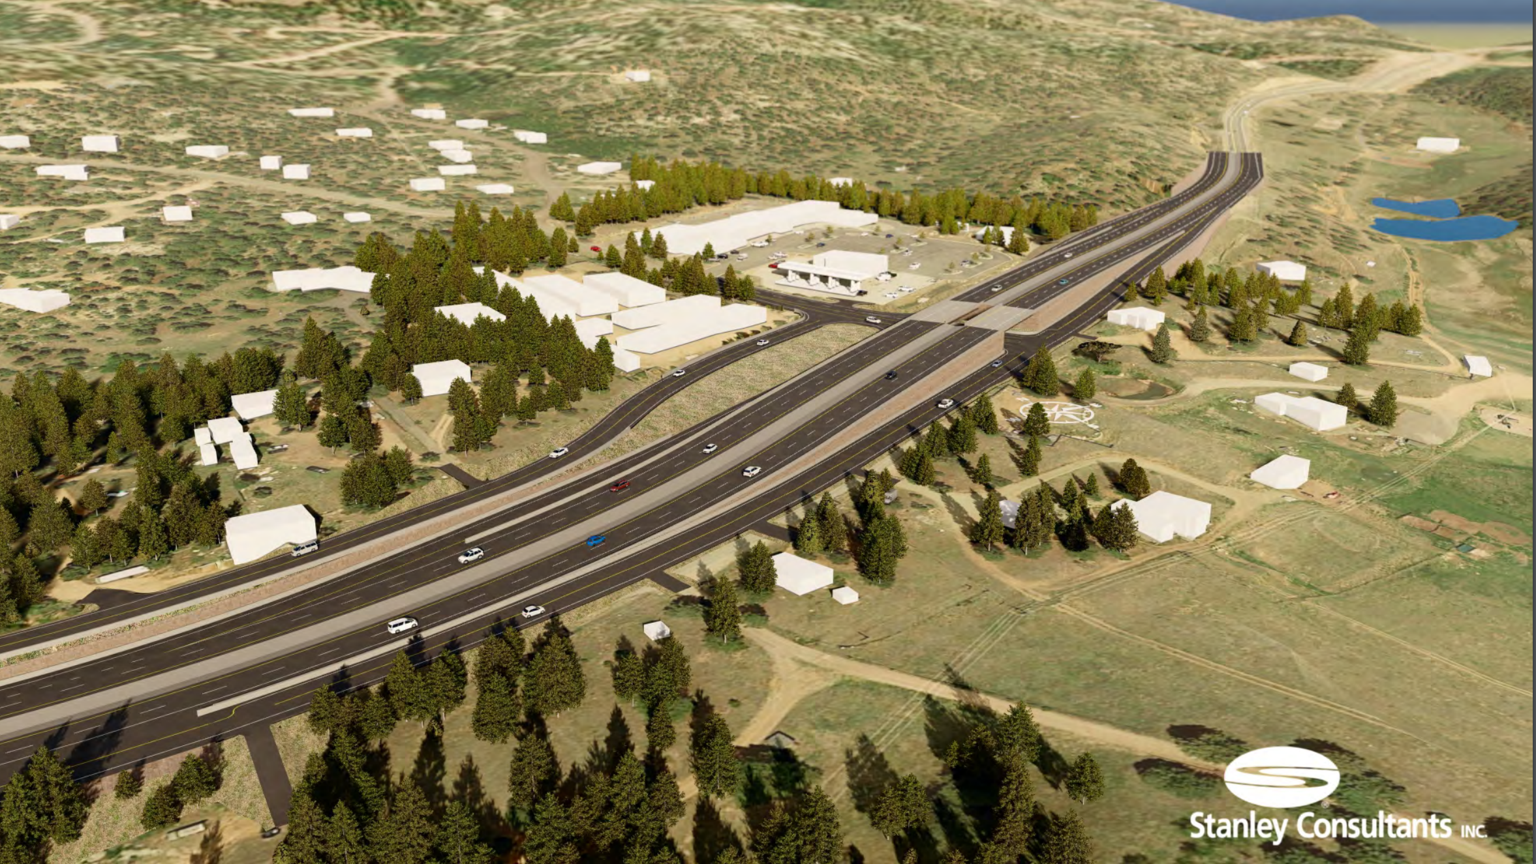
US-285 & Kings Valley Drive
Updated Preferred Alternative
Next Steps:
CDOT to procure consultant to complete final design and environmental re-evaluation. (On-Board May 2022)
Final design and all required clearances (18 months)
Shovel ready project by late 2023.
In parallel, continue seeking and identifying funding.

Slide 14
US-285 & Kings Valley Drive
Please visit the US-285 & Kings Valley Drive Interchange project website for project updates, renderings and other information:
https://www.codot.gov/projects/us285-kingsvalley

